Slide 1

CSE (H) with specialization in Machine Learning and Artificial Intelligence
Soft Computing (CSF – 332)
Chapter -2.2
Neural Network Optimization Methods
By: Dr. Monika Singh E11032
DISCOVER . LEARN . EMPOWER

Slide 2
Course Objectives
To introduce soft computing concepts and techniques of artificial neural networks, fuzzy sets, fuzzy logic and genetic algorithms
To understand the various techniques from the application point of view.
To analyze various soft computing techniques and decide the technique to be used in a particular problem situation.
To implement soft computing based solutions for real-world problems

Slide 3
Course Outcomes
CO1 | Identify and describe soft computing techniques and their roles in building intelligent. Machines | 1
CO2 | Recognize the feasibility of applying a soft computing methodology for a particular problem. | 2,4
CO3 | Apply fuzzy logic and reasoning to handle uncertainty and solve engineering problems, genetic algorithms to combinatorial optimization problems and neural networks to pattern classification and regression problems. | 3
CO4 | Effectively use modern software tools to solve real problems using a soft computing approach. | 3
CO5 | Evaluate various soft computing approaches for a given problem. | 4

Slide 4
Table of Contents
Loss functions and optimization
Cross entropy loss
Activation function

Slide 5
Neural Network Optimization Methods

Slide 6
Non-linear Activation Function
The Nonlinear Activation Functions are the most used activation functions. It makes it easy for the model to generalize or adapt with variety of data and to differentiate between the output.
The Nonlinear Activation Functions are mainly divided on the basis of their range or curves.

Slide 7
. Sigmoid or Logistic Activation Function
The Sigmoid Function curve looks like a S-shape. The sigmoid function is a non-linear AF used primarily in feedforward neural networks.
It is a differentiable real function, defined for real input values, and containing positive derivatives everywhere with a specific degree of smoothness.
The sigmoid function appears in the output layer of the deep learning models and is used for predicting probability-based outputs.

Slide 8
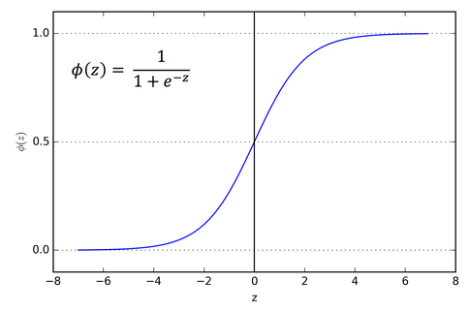
Fig. Activation function
Equation : f(x) = 1 / 1 + exp(-x)
Range : (0 to 1)

Slide 9
Sigmoid activation function
Pros:
1. The function is differentiable. That means, we can find the slope of the sigmoid curve at any two points.
2. The function is monotonic but function’s derivative is not
Cons:
1. It gives rise to a problem of “vanishing gradients”, since the Y values tend to respond very less to changes in X
2. Secondly , its output isn’t zero centered. It makes the gradient updates go too far in different directions. 0 < output < 1, and it makes optimization harder.
3. Sigmoids saturate and kill gradients.
4. Sigmoids have slow convergence.

Slide 10
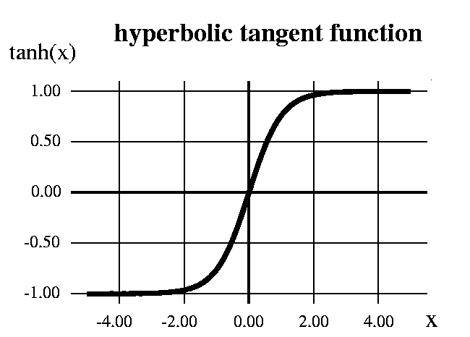
Tanh or hyperbolic tangent Activation Function
The hyperbolic tangent function, a.k.a., the tanh function, is another type of AF. It is a smoother, zero-centered function having a range between -1 to 1. As a result, the output of the tanh function is represented by:
Equation : f(x) = 1 — exp(-2x) / 1 + exp(-2x) or 2 *sigmoid(2x)-1
Range : (-1 to 1)

Slide 11
Tanh or hyperbolic tangent Activation Function
Pros:
The function and its derivative both are monotonic
Output is zero centered
Optimization is easier
Cons:
It also suffers vanishing gradient problem
It saturate and kill gradients.

Slide 12
ReLU (Rectified Linear Unit)
The ReLU is the most used activation function in the world right now.
The ReLU function is another non-linear activation function that has gained popularity in the deep learning domain.
ReLU stands for Rectified Linear Unit.
The main advantage of using the ReLU function over other activation functions is that it does not activate all the neurons at the same time.

Slide 13
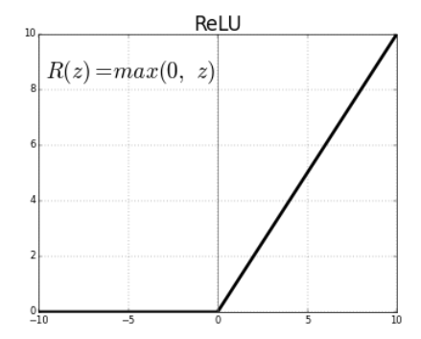
Continue: ReLU Activation function
Equation : f(x) = max(0,x)
Range : (0 to infinity)

Slide 14
ReLU Activation function
Pros:
The function and its derivative both are monotonic.
Due to its functionality it does not activate all the neuron at the same time
It is efficient and easy for computation.
Cons:
The outputs are not zero centered similar to the sigmoid activation function
When the gradient hits zero for the negative values, it does not converge towards the minima which will result in a dead neuron while back propagation.

Slide 15
Summary
Activation functions consider the output to be produced then according performs the functions.
The various categories are being explored.

Slide 16
Questions…
What do mean by non linear activation function?
What is the difference between ReLU and tanh activation function?

Slide 17

References
Book:
S.N.Sivanandam, S.N Deepa, “Principles of Soft Computing”
Websites:
https://nptel.ac.in/courses/106/105/106105173/
Videos:
https://www.youtube.com/watch?v=mlfM4SGOAgo

Slide 18
THANK YOU
For queries
Email: monika.e11032@cumail.in

